Slide 1
أكـــــاديميــــة طــــويـــق
Artificial Intelligence Ethics

Slide 2
Building Accountable AI Systems
By: Dr. Afshan Hashmi

Slide 3
Course Objectives:
Understand the concept of accountable AI
Identify key components of an AI accountability framework
Explain the role of tracking and auditing mechanisms
Evaluate human-in-the-loop (HITL) approaches.
Analyze real-world case studies
Apply best practices.

Slide 4

Introduction to Accountable AI Systems
Accountability in AI refers to the ability to assign responsibility for AI-driven decisions and actions. As AI systems become more autonomous, ensuring accountability is crucial to prevent harm, maintain trust, and comply with regulations.
Key Objectives:
Ensure transparency in AI decision-making.
Establish clear responsibility for AI outcomes.
Enable auditing and oversight mechanisms.
Maintain human control where necessary.
Why is it Important?
Prevents misuse or unethical outcomes.
Ensures compliance with laws and regulations (e.g., GDPR, AI Act).
Builds public trust and acceptance.
Enables fair, unbiased, and just AI decision-making.

Slide 5
Designing AI Systems with Clear Accountability Frameworks
What is an Accountability Framework?
An accountability framework in the context of AI refers to a structured approach for defining and managing responsibility, transparency, and oversight within the design, deployment, and operation of AI systems.
It ensures that the AI system is not a black box, but rather a well-documented, traceable, and fair system where decisions can be explained, challenged, and improved.
Key Elements of an AI Accountability Framework:
1. Transparency
Ensure that how the AI system works is clear.
Includes documentation of:
Algorithms used
Data sources and preprocessing steps
Model decision-making logic
Helps build trust with stakeholders and regulators.

Slide 6
Designing AI Systems with Clear Accountability Frameworks
Key Elements of an AI Accountability Framework:
2. Documentation
Maintain detailed records of:
Design decisions
Training data characteristics
Model updates or tuning
Validation metrics
Acts as a reference for audits, debugging, and future improvements.
3. Attribution
Clearly identify:
Who developed the model?
Who is responsible for monitoring?
Which department owns the system?
Ensures that accountability lies with a team or person, not just the "AI."

Slide 7
Designing AI Systems with Clear Accountability Frameworks
Key Elements of an AI Accountability Framework:
4. Evaluation & Monitoring
Continuous performance checks:
Is the model fair to all groups?
Is it making biased or incorrect predictions?
Regular audits using tools like:
Fairness dashboards
Drift detection tools
Explainability methods (e.g., LIME, SHAP)

Slide 8
Designing AI Systems with Clear Accountability Frameworks
Why Is It Important?
Regulatory Compliance: Many regions now mandate explainable and fair AI (e.g., GDPR in the EU).
Ethical Assurance: Helps avoid harm due to bias or unexplainable errors.
Organizational Trust: Promotes confidence among users, stakeholders, and clients.
Operational Continuity: Ensures issues can be traced and resolved efficiently.
Tools & Practices for Building Accountable AI:
Documentation: Model cards, data sheets for datasets
Explainability: SHAP, LIME
Governance Platforms: IBM AI Factsheets, Google’s Model Monitoring
Ethical Frameworks: OECD AI Principles, EU’s AI Act

Slide 9
Key Components of an Accountability Framework:
Component | Description
Governance Structure | Defines roles and responsibilities (e.g., AI ethics committee, developers, compliance officers)
Documentation | Maintains records of datasets, model versions, decision rationale
Ethical Principles | Embeds values such as fairness, privacy, and human rights
Audit Trails | Tracks decisions and how they were made
Policies & Standards | Aligns with legal and organizational policies (e.g., bias testing, model risk management)
Example:
In a loan approval system, the framework should:
Log who approved the training dataset.
Track decisions made by the AI.
Allow customers to appeal and get explanations.

Slide 10
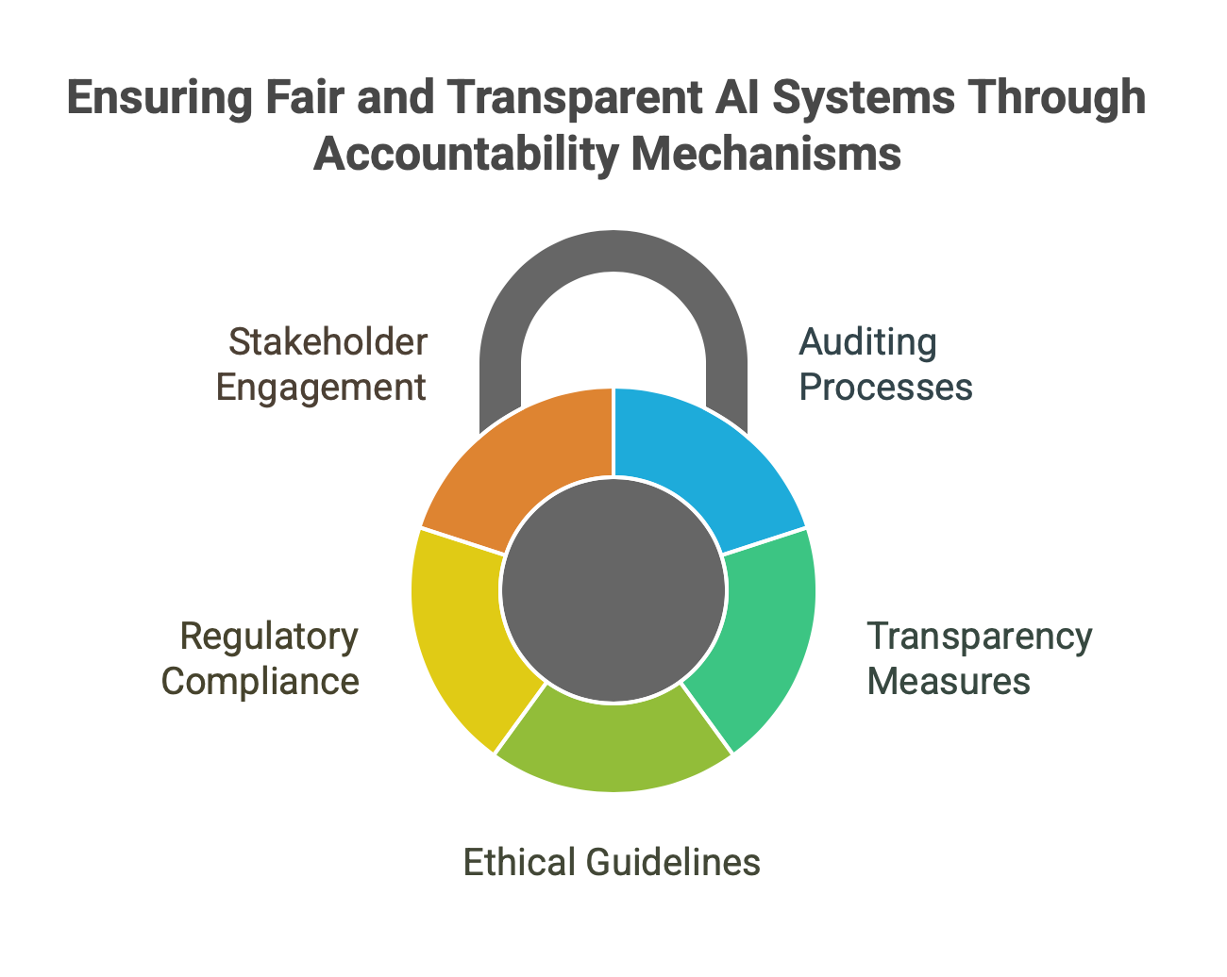
Mechanisms for Tracking and Auditing AI Decision-Making
As AI systems become more influential in areas like finance, healthcare, education, and justice, it's essential that every decision they make can be tracked, understood, and justified. This is where auditing mechanisms come into play.
Below are five core mechanisms used to ensure accountability, transparency, and fairness in AI.

Slide 11
A. Logging and Monitoring
Model Inputs & Outputs What it means: Every time an AI system makes a prediction, record the data it received (input) and the prediction it made (output). Why it matters: Helps in tracing back to see why the model made a certain decision, especially in critical applications like fraud detection or medical diagnosis. Example: An AI model denies a loan application. Logs show the input features: age, credit score, income. Output: “Not eligible” with a confidence score of 0.85.
2. Metadata Tracking
What it includes:
Model version used
Date/time of prediction
Confidence score
Type of device or location (if relevant)
Who triggered the prediction (user/system)
Purpose: Ensures every action is traceable, allowing teams to audit behavior across versions and use contexts.

Slide 12
B. Model Cards and Data Sheets
Inspired by food nutrition labels, these provide standardized documentation for AI systems and datasets.
Model Cards:
Describe a trained model in terms of:
Purpose and use cases
Performance across various data segments
Limitations and known issues
Ethical and fairness considerations
Data Sheets:
Focus on the datasets used in training/testing:
How the data was collected
Intended use of the data
Potential biases
Preprocessing steps
Why Use These?
They communicate model behavior clearly to developers, reviewers, and non-technical stakeholders.
Encourages transparency and ethical thinking during model development.

Slide 13
C. Explainability Tools
Tools like:
SHAP (SHapley Additive exPlanations)
LIME (Local Interpretable Model-Agnostic Explanations)
Purpose:
These tools explain why a model made a specific prediction by highlighting the most influential features.
They break the “black-box” nature of many ML models like deep neural networks and ensemble trees.
Example:
A SHAP graph might show that for a patient diagnosed with diabetes risk, the most influential factors were age, BMI, and glucose level.

Slide 14
D. Audit Trails
What are they?
Digital logs that chronologically record each action, change, or decision the AI system makes.
Why important?
Allow internal or external parties to review the historical performance of the system.
Especially useful for:
Legal investigations
Security breaches
Regulatory compliance
Example:
A healthcare audit reveals that an AI model made several misdiagnoses on a certain population group. The trail shows a recent model update introduced a bias.

Slide 15
E. Bias & Fairness Audits
Purpose:
To test if the AI model unintentionally discriminates against any group based on age, gender, ethnicity, etc.
Tools:
Fairlearn (by Microsoft)
AI Fairness 360 (by IBM)
These tools quantify bias and help retrain models to reduce it.
Example:
In a job recruitment AI, if it selects fewer female candidates despite similar qualifications, a fairness audit can uncover and fix the bias.

Slide 16
Real-Life Example: AI in Healthcare
Let’s say an AI system recommends treatments based on patient data:
Logging captures input symptoms, history, and suggested treatment.
Metadata includes which version of the model was used.
SHAP explains that “low white blood cell count” was the main reason behind the recommendation.
Model Card outlines that this model performs less accurately on children under 12.
Audit Trail shows a doctor overrode the AI suggestion twice that week.
Bias Audit highlights that the system underperforms on patients from certain ethnic backgrounds.

Slide 17
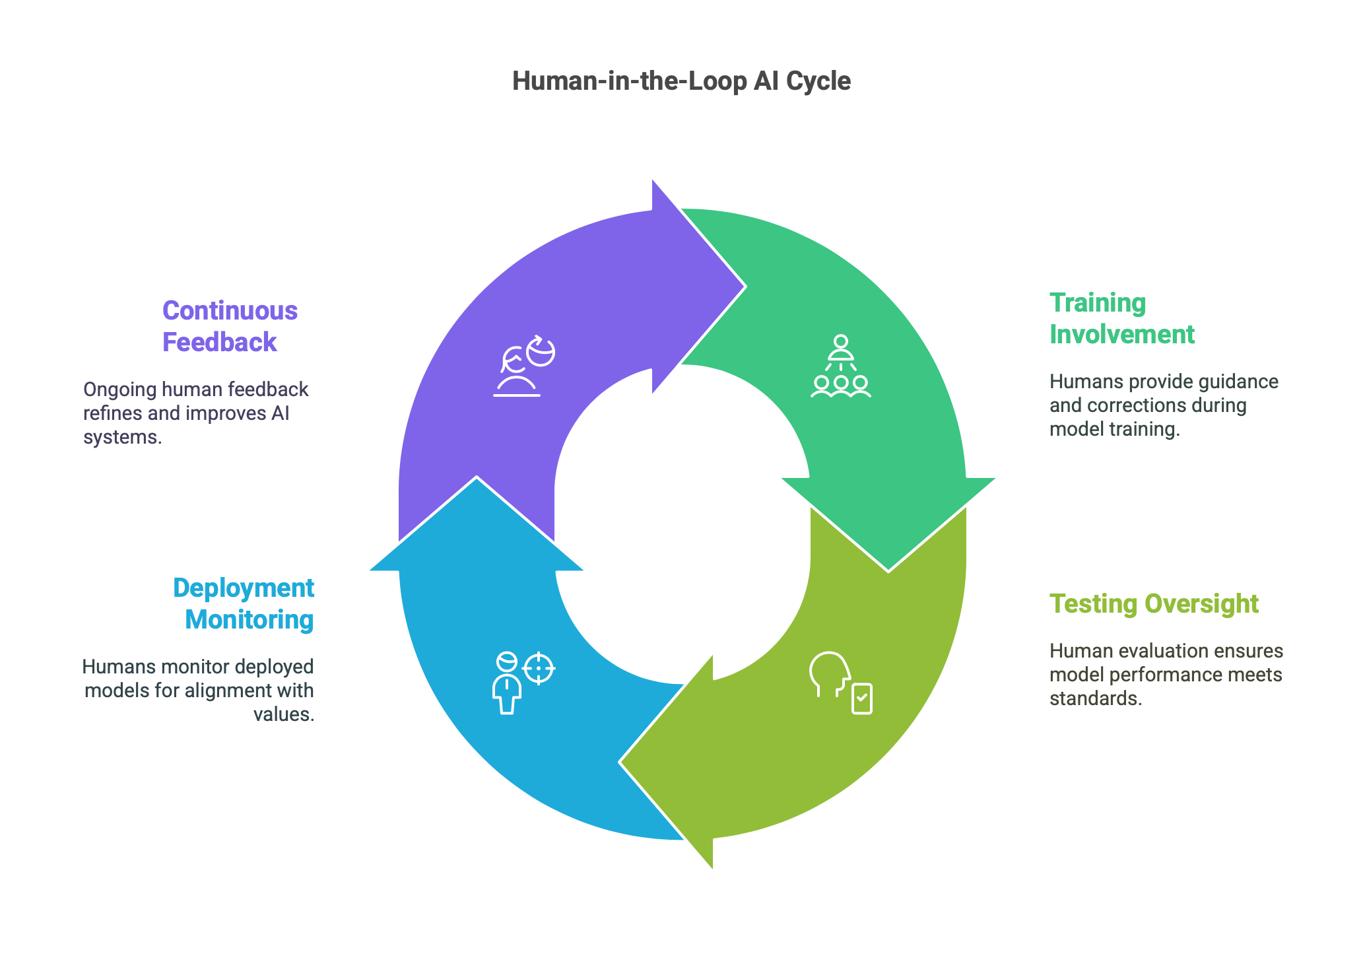
Human-in-the-Loop (HITL) Approaches in AI
Human-in-the-loop (HITL) is a strategy in AI system design where humans are actively involved in the model lifecycle from training and testing to deployment and monitoring to provide oversight, guidance, and corrections.
This approach is especially important in sensitive or high-stakes domains, where automated systems must be auditable, ethical, and aligned with human values.

Slide 18
Human-in-the-Loop (HITL) Approaches in AI
A. Types of HITL Models
These models ensure ethical governance and retain human judgment,
especially where errors could have significant consequences.
Type | Description | Example
Pre-decision | A human reviews or configures the input or training data before the AI system acts. | Doctors examine and clean a dataset used to train an AI for diagnosing cancer.
Mid-decision | AI gives a suggestion or output, and a human evaluates or overrides it in real-time. | A recruiter reviews AI-recommended candidates before inviting them to interviews.
Post-decision | AI executes a decision or action, and humans audit, review, or correct the output afterward. | A fraud detection AI flags transactions; analysts investigate and approve/reject.

Slide 19
B. Benefits of HITL
1. Ethical and Responsible AI
Prevents AI from making fully autonomous decisions that may be biased or incorrect.
Ensures decisions are aligned with human norms, values, and regulations.
2. Improved Decision-Making
Combines AI's speed and pattern recognition with human judgment and context-awareness.
Especially critical in healthcare, law enforcement, finance, and recruitment.
3. Transparent and Traceable AI
Enables documentation and justification of decisions, boosting trust and accountability.
4. Continuous Learning
Human feedback can be used to fine-tune or retrain models, improving their accuracy and fairness over time.

Slide 20
C. Challenges of HITL
1. Slower Workflow
Involving humans at each stage may slow down operations compared to fully automated systems.
Example: Reviewing hundreds of AI-generated resumes takes time.
2. Need for Skilled Personnel
Personnel must understand how to interpret AI outputs, identify biases, and provide meaningful feedback.
This often requires training and awareness programs.
3. Risk of Overreliance on AI
Even with human oversight, people may blindly follow AI suggestions, especially when AI is perceived as highly accurate.
This can lead to rubber-stamping behavior without critical evaluation.

Slide 21
Real-World Use Cases
Healthcare
Pre-decision: Medical experts curate and validate training data for radiology models.
Mid-decision: A radiologist uses an AI tool to detect tumors but makes the final call.
Post-decision: Hospital reviews treatment recommendations after patient feedback or outcomes.
HR and Recruitment
AI scores resumes → Human checks for bias or missing nuances → Final list sent to interviewers.
Finance
AI detects potentially fraudulent transactions → Human analysts verify and take action.

Slide 22
Google Photos Tagging Incident — A Case Study in AI Accountability
Problem: AI Mislabeled African-Americans as “Gorillas”
In 2015, Google Photos’ AI-based image recognition system automatically tagged African-American individuals in photos as “gorillas.” This was not only a technical failure but also a deeply offensive and harmful mistake, sparking widespread public outrage.
Accountability Issue
1. Inadequate and Biased Training Data
The model was likely trained on a dataset not representative of diverse racial groups.
Underrepresentation of people of color in the training set led to misclassification due to lack of feature differentiation.
2. Lack of Human Review and Testing
The system went live without thorough Human-in-the-Loop testing, especially for sensitive and socially impactful labels.
There was no safety mechanism or human audit to detect and correct this harmful classification before deployment.

Slide 23
Google Photos Tagging Incident — A Case Study in AI Accountability
Solution: Human-in-the-Loop and Dataset Audits
To address the problem, Google implemented several measures, including:
1. Stricter HITL Testing
Introduced human review checkpoints during AI training and testing.
Now, sensitive labels (like race, gender, religion) undergo manual verification and are often disabled by default to avoid offensive outputs.
2. Improved Dataset Curation and Auditing
Conducted bias audits on training datasets to ensure diverse and representative samples.
Applied data augmentation and rebalancing techniques to reduce bias.
3. Limiting Sensitive Categories
For example, Google removed the ability to tag images as “gorillas” altogether to prevent similar incidents until the technology improves.

Slide 24
Best Practices Checklist for Building Accountable AI
Assign clear roles (e.g., Data Steward, Ethics Officer)
Maintain detailed documentation (Model cards, Data sheets)
Use explainable AI tools (SHAP, LIME)
Conduct regular bias and fairness audits
Build feedback loops and appeal mechanisms
Involve humans in sensitive decisions
Monitor performance post-deployment
Ensure compliance with relevant legal frameworks (GDPR, AI Act)

Slide 25
Summary
Accountable AI ensures transparency, fairness, and ethical responsibility in AI systems, especially in sensitive applications like healthcare and justice.
Accountability frameworks define roles, responsibilities, ethical guidelines, and documentation processes to govern AI lifecycle and decision-making.
Tracking and auditing mechanisms—including logging, model cards, explainability tools (like SHAP, LIME), and bias audits—help monitor and understand AI decisions.
Human-in-the-loop (HITL) approaches involve human oversight during AI input, decision-making, or post-decision review, ensuring control and reliability.
Case studies reveal the risks of lacking accountability (e.g., COMPAS bias, Google Photos mislabeling) and stress the need for ethical checks.
Best practices include using explainable AI, regular audits, stakeholder involvement, proper documentation, and compliance with legal regulations.

Slide 26
Resources for Further Study
EU AI Act (Regulation on AI accountability)
Google’s Responsible AI Practices
IBM’s AI Fairness 360 Toolkit
Ethics of AI – Stanford Encyclopedia
Microsoft Responsible AI
Google Responsible AI

Slide 27

















الشراكات العالمية

Slide 28
شــــــكــــرًا لكــــــم
THANK YOU

